Slide 1
Shortest Path Algorithm
Fastest route finder

Slide 2
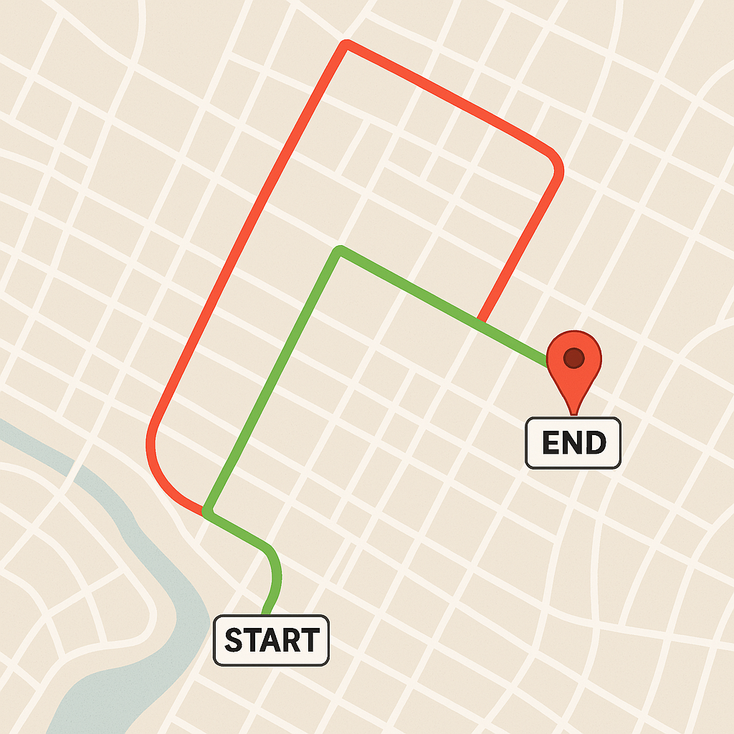
Introduction
Efficient route planning is essential for navigation, whether for daily commuting, logistics, or travel. This presentation explores different routes from a starting point to a destination, highlighting optimal and suboptimal paths. Longer routes are marked in red, indicating less efficient choices, while shorter and best routes are marked in green, ensuring minimal travel time and better efficiency. By analyzing these routes, we can make informed decisions to save time and resources.

Slide 3
Benefits of Our Project
Time Savings – Choosing the best route reduces travel time, allowing for quicker commutes and deliveries.
Fuel Efficiency – Shorter routes help in conserving fuel, leading to lower expenses and less Harm To Nature
Cost Reduction – Businesses can save on transportation costs by optimizing delivery and travel routes.
Reduced Traffic Congestion – Using the best routes helps avoid heavy traffic, leading to smoother journeys.
Improved Productivity – Less time spent on the road means more time for other important tasks.
Enhanced Safety – Optimized routes can help avoid accident-prone areas, improving overall road safety.
Better Decision-Making – Route planning helps individuals and businesses make informed travel decisions.

Slide 4
Comparison
Shortest Algorithm
Google Map
 | Uses an advanced pathfinding algorithm for faster and more optimized shortest routes.
 | Allows personalized route preferences based on user needs (e.g., avoiding traffic, tolls, or rough roads).
 | Integrates real-time data efficiently to adapt routes dynamically.
 | Optimized for minimal battery and data usage.
 | Focuses solely on shortest and most efficient paths with precision.
 | Lightweight and faster processing for quick calculations.
Relies on standard algorithms, sometimes favoring main roads over actual shortest paths.
Limited customization; often prioritizes highways and major roads.
Uses real-time traffic data but may not always suggest the absolute shortest route.
Higher battery and data consumption due to background processes.
Balances shortest route with other factors, sometimes leading to longer travel times.
Heavier application with multiple features that may slow down processing.

Slide 5
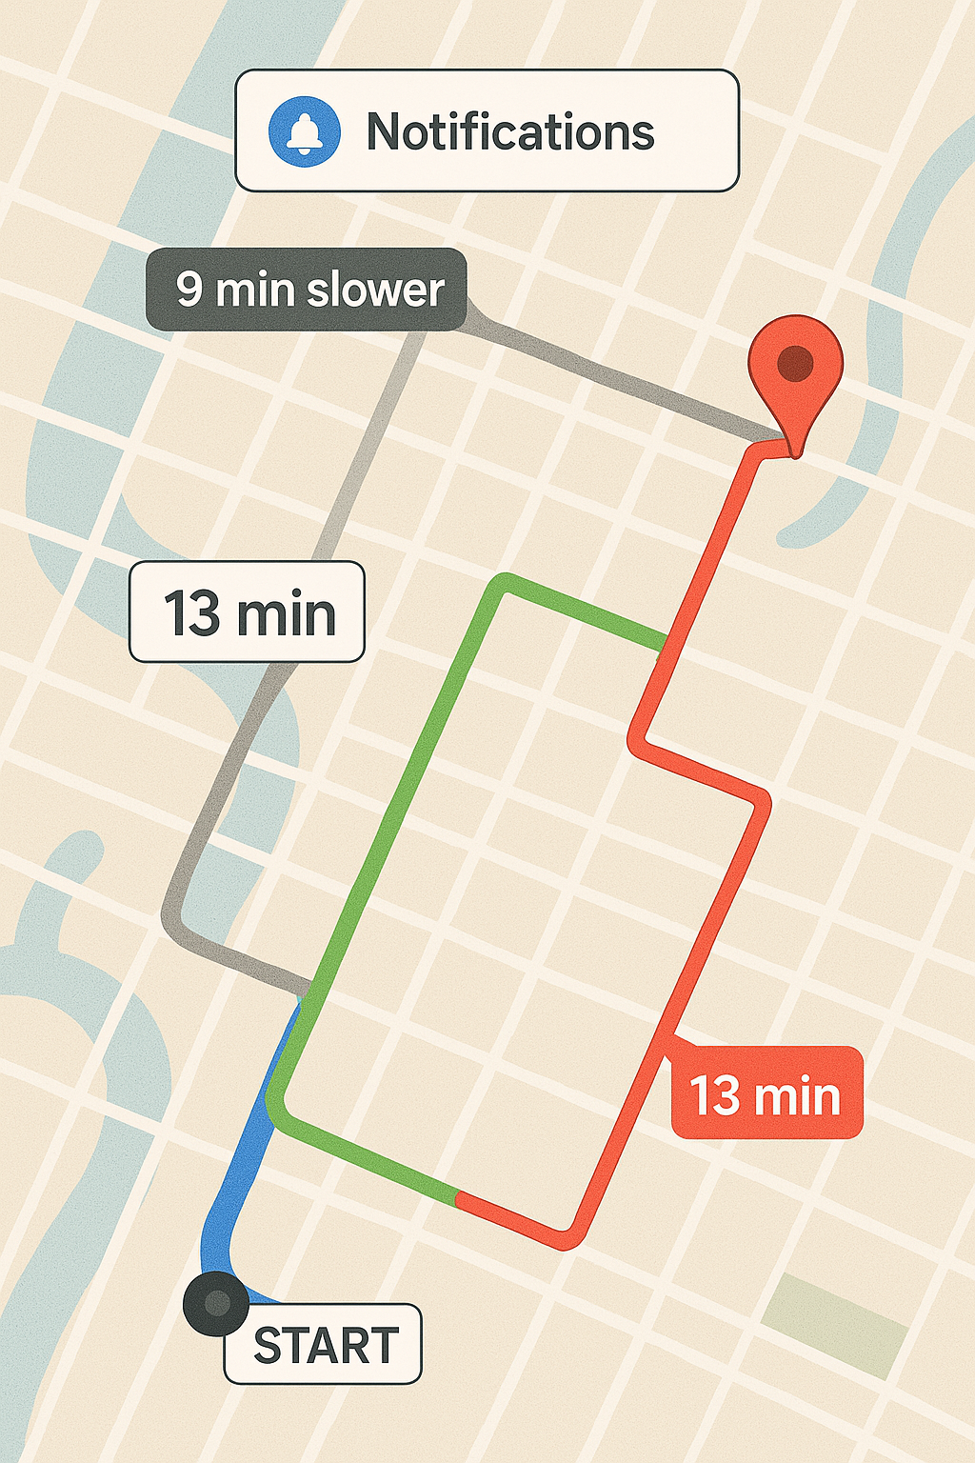
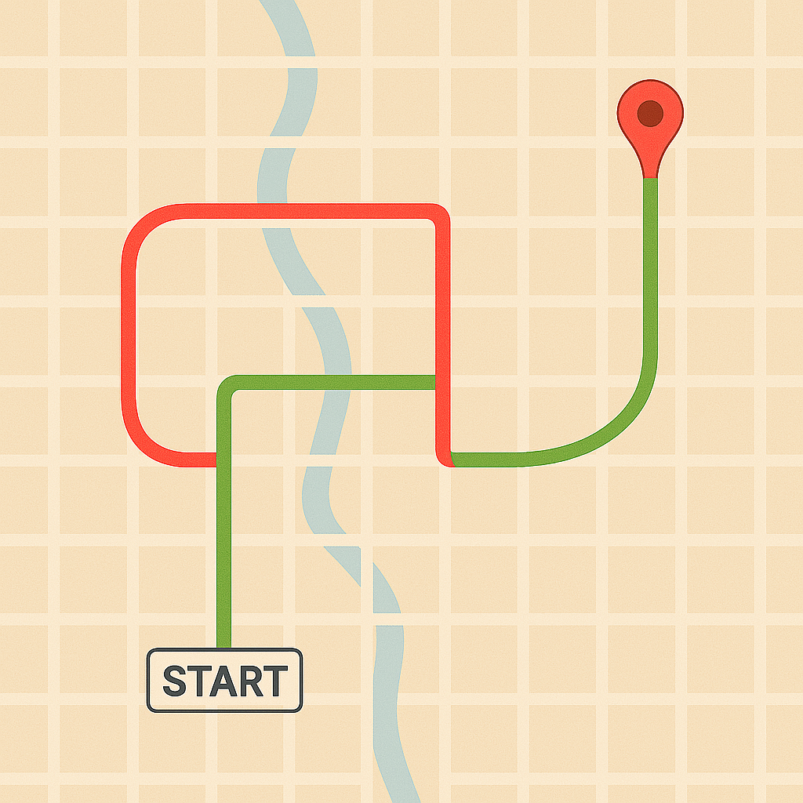
Difference b/w google map and our Algorithm

Slide 6
Conclusion
Our project aims to revolutionize navigation by providing a more efficient and optimized shortest-route algorithm, surpassing existing solutions like Google Maps. By leveraging advanced pathfinding techniques and real-time data analysis, our system ensures faster, more accurate, and customized routes. This innovation not only enhances user experience but also minimizes travel time, fuel consumption, and congestion. With this project, we take a step toward smarter and more intelligent navigation solutions for everyday users.

Slide 7
Thank You !

